Slide 1
Blockchain as a Potential Disruptive Technology
for Energy Domain
Önder Gürcan
Trustworthy, Smart and Self-Organizing Information Systems Laboratory
CEA LIST
01.11.2019
Notes:
1
1

Slide 2
Roadmap
Part I: An Industrial Prototype of Trusted Energy Performance Contracts using Blockchain Technologies
Part II: Simulating Blockchain Systems using Multi-Agent eXperimenter

Slide 3


Part I
An Industrial Prototype of
Trusted Energy Performance Contracts
using Blockchain Technologies
Önder GÜRCAN, Marc AGENIS-NEVERS, Yves-Marie BATANY,
Mohamed ELMTIRI, François LE FEVRE, Sara TUCCI-PIERGIOVANNI
16th IEEE Internatonal Conference on Smart City (SmartCity-2018),
June 28-30, 2018, Exeter, UK.

Slide 4
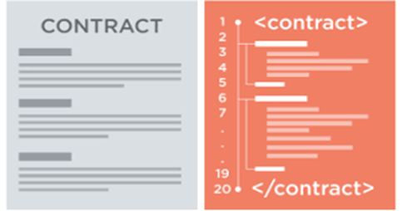
Energy Performance Contracts
an intelligent contractual framework where
  energy savings (S) = a predictive baseline model (E_{b}) – the actual consumption (E)
Linear:
R scripts...
Complex:
Machine Learning,
Tıme-dependent...
(e.g.,
shopping
malls,
hotels)
Client
Other
(e.g., Meteo France)
Contractor
(e.g., Veolia)
savings are generally computed on a basis of one month and financial transactions occurs once a year.

Slide 5
The Pain in Energy Performance Contracts (EPCs)
Proposed Solution: Blockchaining EPCs!

Slide 6
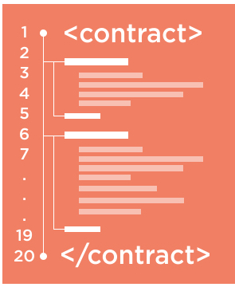
The Blockchain Technologie
Blockchain
Head
48
n₄₈
t₄₈
$_{R}+ ∑$_{F}
49
n₄₉
t₄₉
$_{R}+ ∑$_{F}
50
n₄₈
t₅₀
$_{R}+ ∑$_{F}
Genesis
Block
49
$
50
$
Main
chain
C->F,50
D->A,30
A->B,50
0
1
$
2
$
…
48
$
C->D,30
F->A,30
D->C,30
49
$
B->E,40
E->D,50
E->F,40
Fork
Proof-of-Work
Proof-of-Stake
…
Blockchain: an immutable append-only ledger of transactions.
  can be public/private, permissionless/permissioned etc.
Smart contract: a computer code intended to digitally facilitate, verify, or enforce the rules of a real contract.
  deployed to a blockchain,
  deterministically executed in all blockchain clients.

Slide 7


Challenges of Blockchaining EPCs
#1 Trusting Predictive Models and Data
  How can everyone be sure that the predictive models will be executed as agreed in the contract?
#2 Auditing without a Trusted Third-Party
  How can everyone be sure the data are not modified during the execution of the contract?
#3 Tackling with the Limitations of Blockchains
  How can the predictive models be transformed into smart contracts?
  How to design the interface between the blockchain and the external data sources (oracles)?
Notes:
#1 Trusting predictive models and data
How can everyone be sure that the predictive models will be executed as agreed in the contract?
#2 Auditing without a trusted third party
How can everyone be sure the data are not modified during the execution of the contract?
#3 Limitations of blockchains
How can the predictive models (R scripts) be transformed into smart contracts?
No floating-point support, limited memory etc.
How to design the interface between the blockchain and the external data sources (oracles)?
The blockchain does not guarantee the "truthfulness" of the registered information. Thus, we need a data qualification process where:
Authorized data sources and
A “voting” algorithm,
are hardcoded inside smart-contract(s).

Slide 8
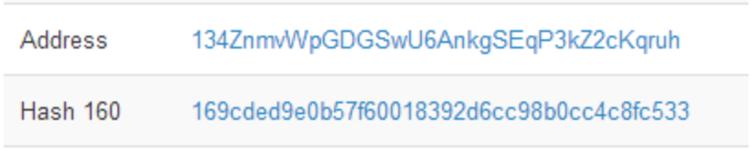
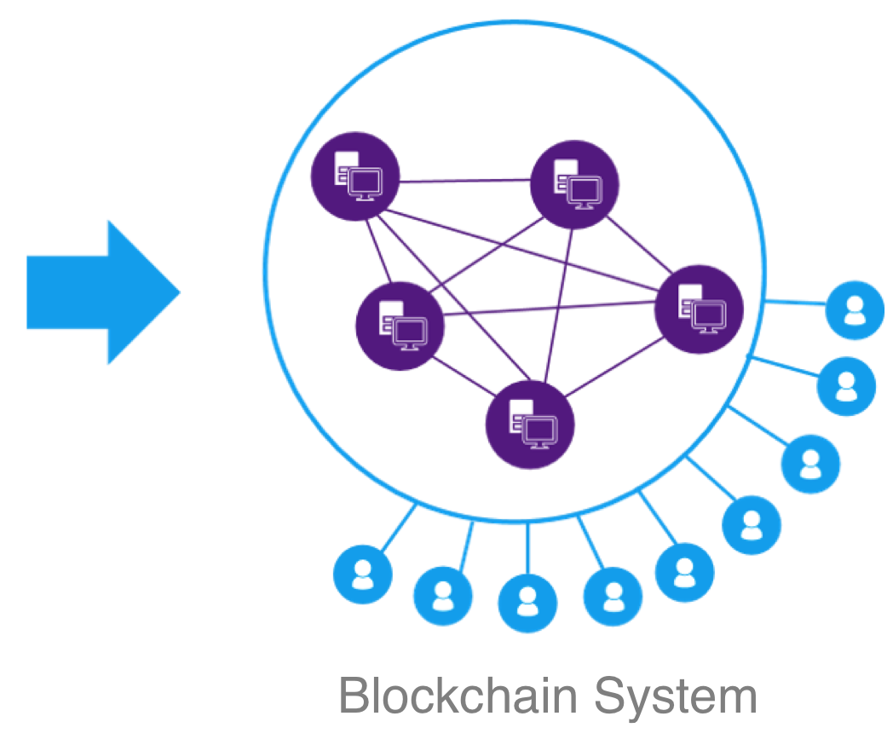
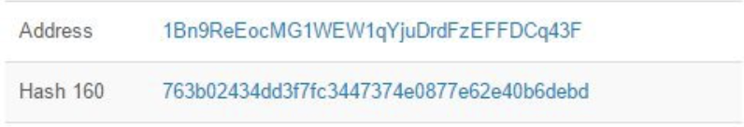
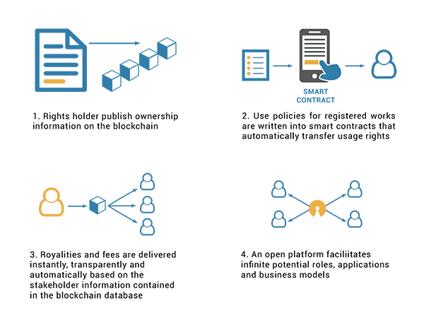

A New Contracting Process
2
3
4
1
Definition of the contrat
Programming corresponding smart contrats
Deployment into the blockchain
system
Execution in the blockchain
Agreement on:
Predictive Model
Usage Conditions
Energy Price
Data qualification process
Generation of blockchain adresses (IDs)
(Client, Veolia, Meteo France)
The "smart contract" is executed only if it is called via its address.
Generation of smart contract adresses (ID)
Security rule: the conditions granted are "hard coded" in the "smart contracts": not possible to update them afterwards.
If the contract changes (step 1), a new smart contract shall be rolled out (step 2).
Notes:
Ce slide fait partie des perspectives
Evoquer les overtures sur la gestion des contracts et la possibilité de mettre dans la bc de modele plus complexes.
Phase 3 Rajouter comment les sources sont registrées dans la BC (avant les smart contract dans 2) et rajouter une étape 4 la phase exploitation des smart contracts et le cas d’àvenant
Perspectives:
Modele predictif complexe
Cycle de vie smart contract
Contrôle d’acces sur blockchain
OPEX: ether publique: audit une fois par moi plus transactions en phase de suivi pour un contract (paramétrer par rapport aux sources min. 2)

Slide 9
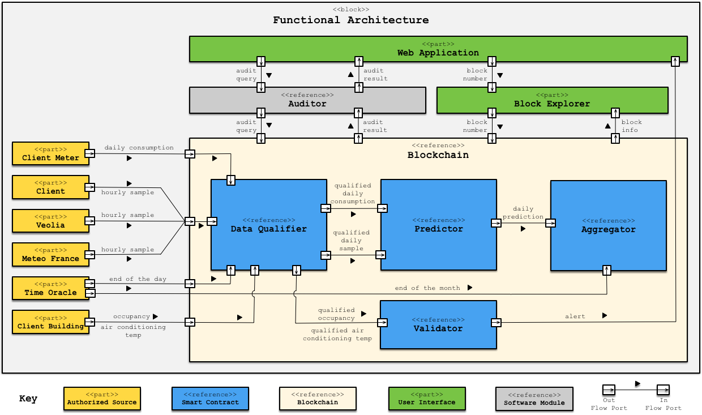
Functional Architecture of the Prototype
Audit
Process
«Voting» determines a «reliability» value of the output.
  Authorized
  Data
  Sources
  Blockchained
  Energy
  Performance
  Contract
Notes:
Agencer l’architecture fonctionnelle pour que soit plus lisible
Partie financière à rajouter à l’Aggregator
savings à convertir : le cout de l'énergie est codé en dur dans le smart contract
plus bonus/malus

Slide 10
Data Qualification by « Voting »
Meteo France
Client
Veolia
DECISION PROCESS
We group the sources into subgroups of agreement between them (thus 2 or 3 subgroups), wrt close tolerance.
We keep the subgroup that has the most weight.
The valid value is the average of the source(s) with the greatest weight within the subgroup.
The reliability is the sum of the votes of the chosen group
Tolerances:
Temperature: 0.5°C
Humidity: 5 points of percentage
Pression: 10 mbar
4
3
3
Closest group (wrt the tolerance) of two is chosen
more reliable
23°
23.4°
23.8°
23°
R=7
Closest group (wrt the tolerance) of two is chosen
23°
divergent
25°
25,2°
25,1°
R=6
Notes:
Merci Onder pour ces slides très bien faites et claires.
Je réponds en retard (désolé) concernant la validation des variables.
Voici comment j'imagine le processus de qualification des données climatiques:
nous avons 3 sources a qui on affecte chacune un nombre de voix
meteo france(MF): 4 voix
veolia (VE): 3 voix
client (CL): 3 voix
Tolérances: (adapter si besoin en multipliant par 1000)
Température: 0.5°C
Humidité: 5 points de pourcentage
Pression: 10mbar
La tolérance s'entend comme l'écart d'une source à la source la plus fiable disponible.
PROCESSUS DE DECISION
1. on regroupe les sources en sous-groupes d'accord entre eux (donc 2 ou 3 sous-groupes), à la tolérance près.
2. on conserve le sous-groupe a le plus de poids
3. on choisit comme valeur valide, la moyenne du ou des sources qui ont le plus de poids au sein du sous-groupe.
EXEMPLE1:
MF: 23°
CL: 23.4°
VE:23.8°
ici client et météo france sont considérées identiques et veolia divergente. Dans le groupe MF+CL on conserve MF qui est la plus fiable.
(CL et VE ont pourtant moins de 0.5° d'écart entre elles mais on mesure par rapport à la plus fiable.)
EXEMPLE2:
MF: 23°C
CL: 25°C
VE: 25.2°C
Ici meteo france est anormale. On choisit le groupe MF+VE
Comme les poids sont égaux (3 et 3) on prend la moyenne: 25.1°C
EXEMPLE 3:
MF: 10°C
VE: 5°C
CL: 30°
Personne n'est d'accord, on prend la source Meteo France: 10°C
je n'ai pas réfléchi à un formalisme de ca en code, mais ca doit pas etre trop compliqué?

Slide 11
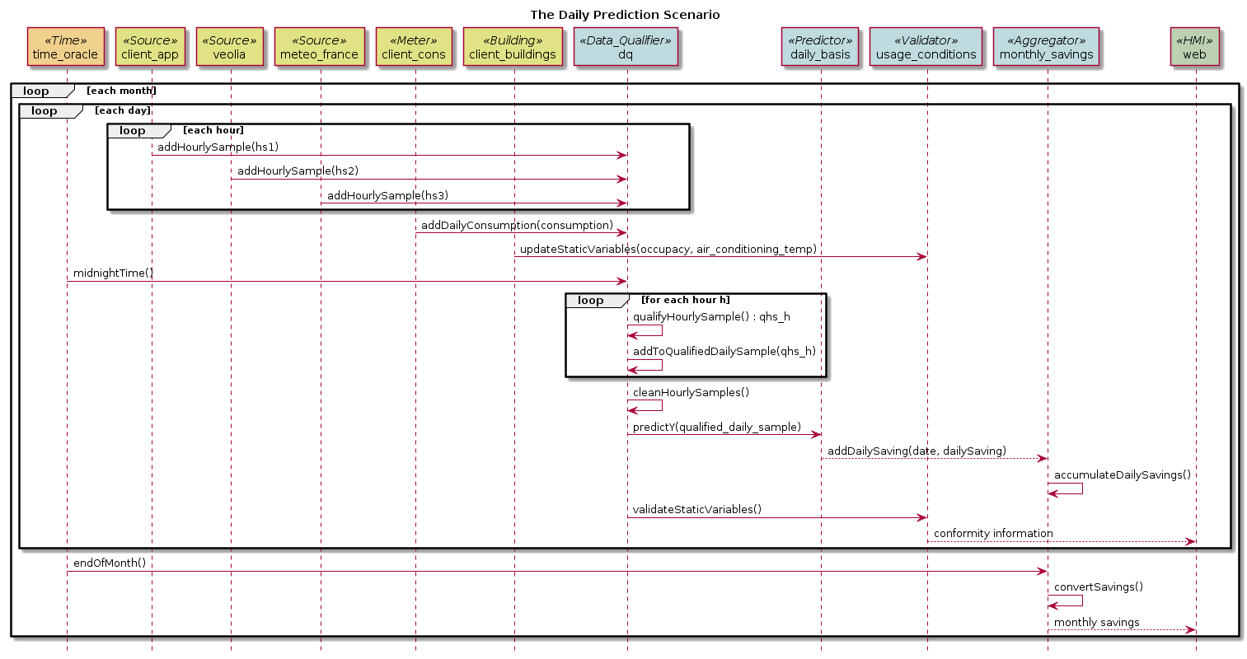
The Daily Prediction Scenario
Hourly data are qualified and registered in the BC.
Daily consumption is qualified, predicted consumption is calculated, savings consumption is calculated and all are registered in the BC.
Monthly savings are calculated and registered in the BC.
Notes:
Slide 10 : mettre en evidence le lien entre les lignes de vie du diagramme de sequence et les block de l'architecture fonctionnelle (même couleur)
Slide 10: modifier les "loop" actuels en : each hour, each day, each month
Savings financier avec Prix d’énergie: 0.1 euro par KW/h
Pas de calcul de bonus/malus

Slide 12
The Daily Prediction Scenario

Slide 13
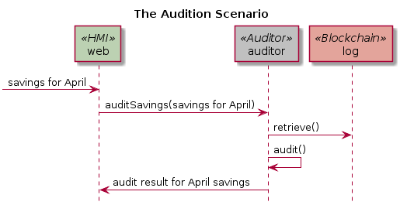
The Audition Scenario
Audit process is conducted through the Web Interface.
Differentes requests are possible:
  E.g., audit the comsumption prediction for 02/11/2015, 12:00.
The results include the reliability values of the data provided by the authorized sources.
Notes:
Remettre à jour par rapport au scenarion montré en démo

Slide 14
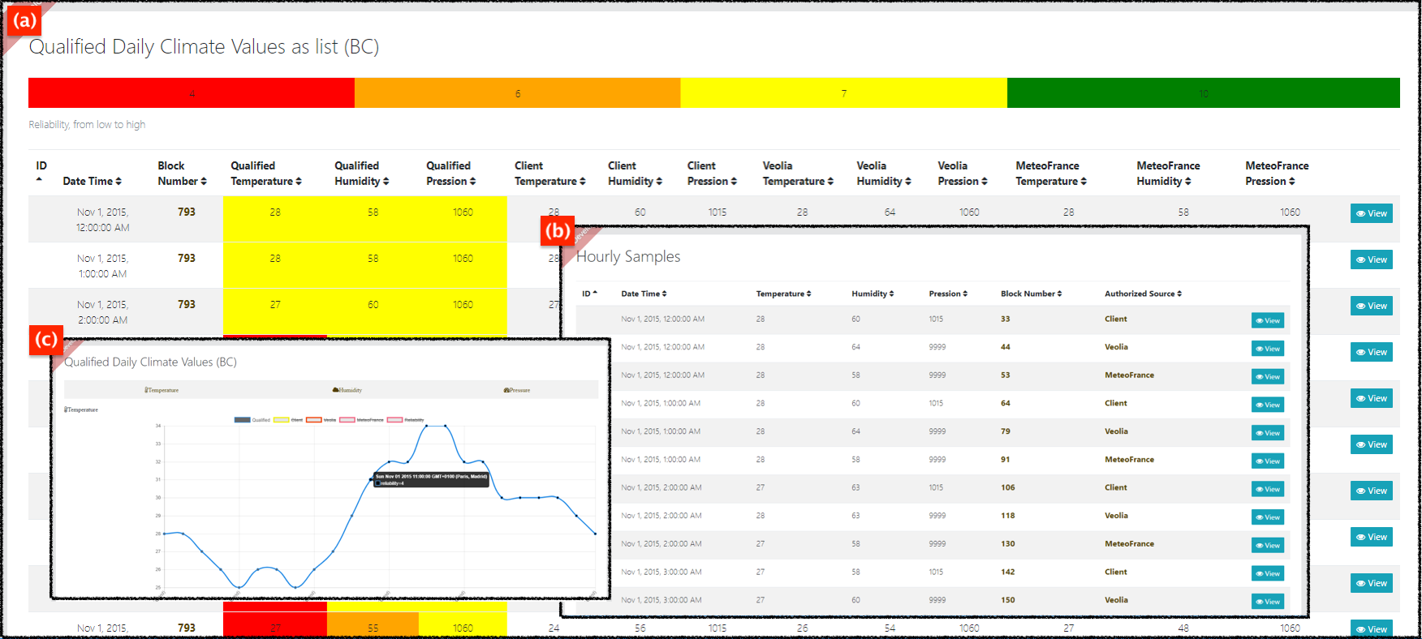
Execution of the Prototype using 5 day real data

Slide 15
Conclusions & Perspectives
Conclusions
  A successful prototype is tested using 5 day real data.
  A linear model, initially implemented in R, is used.
  Several mathematical functions are implemented.
Perspecties
  How to move to a complex predictive model?
    It is necessary to change the execution mechanism of smart contracts.
    Code as data:
      securely executing complex predictive models off-chain and
      registering the results into the blockchain

Slide 16
Part II
Simulating Blockchain Systems using
Multi-Agent eXperimenter
Önder Gürcan
Trustworthy, Smart and Self-Organizing Information Systems Laboratory
CEA LIST
01.11.2019
Notes:
16
16

Slide 17
The Blockchain
The blockchain is a registry that contains the history of all exchanges made between its users since its creation.
The exchanges are stored in the blockchain in a secure, tamper-proof and transparent way.

Slide 18


Anatomy of a Blockchain
height = 51
Blockchain
Head
Genesis
Block
Block Creator P
49
$
50
$
51
$
Main chain
Limited
size
0
1
$
2
$
…
48
$
49
$
Side chain
Fork
Block Creator M
Stale
Block
Quality of
the chain

Slide 19
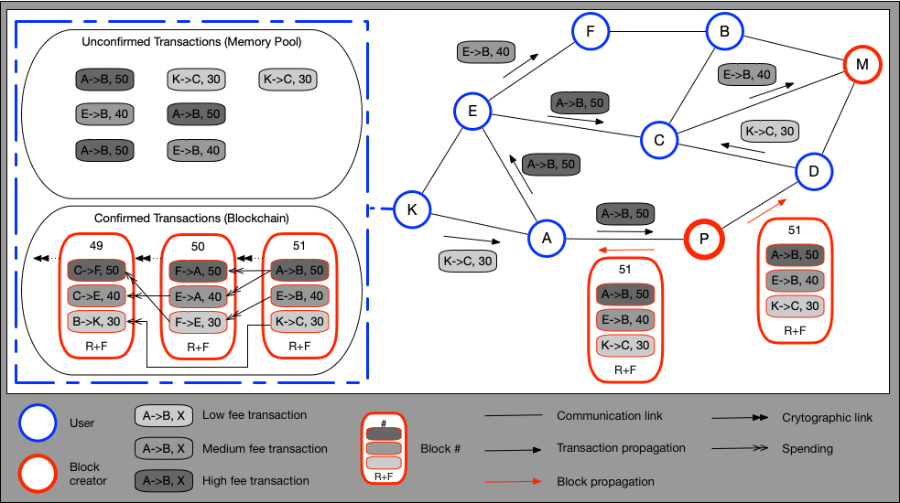
Blockchain Systems
Open, dynamic and distributed system
Social and economical system
Multiple heterogeneous layers/environments and multiple roles
Notes:
19
On va donc abstraire cette vision des choses en l'assimilant à des niveaux parallèles où par exemple on a 1 personne qui veut simplement faire un achat, mais qui sera noté comme une transaction sur une blockchain, ou encore un simple transfert de biens sur un autre niveau tel que Lightning.

Slide 20
Blockchain Systems (cont.)
Blockchain systems are distributed systems
  A distributed system is a collection of independent computers that appears to its users as a single coherent system [Tanenbaum et al. 2007].
  A distributed system is one in which the failure of a computer you did not even know existed can render your own computer unusable [Lamport 1987].
    Tolerant to various types of faults.

Slide 21
Blockchain Systems (cont.)
Blockchain systems are social organizations
  Social organizations are formal or informal groups of interrelated individuals (agents) who pursue a collective goal and who are embedded into an environment [Ostrom 2009].
  The blockchain (data structure) is a physical manifestation of the interactions of users.
  Blockchain systems facilitates cooperation by getting self-interested, distrustful people to work together.
  Conflict of individual/collective goals (e.g., users want lower fees while block creators want higher fees) [Gürcan et al. 2017].
  Continuous enter/exit dynamics [Gürcan et al. 2017].

Slide 22
Blockchain Systems (cont.)
Blockchain systems are economical systems
  S. Nakamoto, “Bitcoin: A peer-to-peer electronic cash system,” 2008.
  An economical system, as any other complex system, reflects a dynamic interaction of a large number of different agents, not just a few key agents.
  The resulting systemic behavior, observable on the aggregate level,
    often shows consequences that are hard to predict (e.g., the transaction fees)
    which cannot be simply explained by the behaviors of a few major agents.

Slide 23
Moreover…
  We face highly competitive (and complex) industrial cases
    that have technical problems: data reliability, confidentiality, archiving, ….
  which are being constantly reshaped by client demands, technology and regulatory requirements.
    Client demands: e.g., performance (# of transactions/minute), fees …
    Technology: e.g., (blockchain) protocol, parameters, cost …
    Regulations: e.g., standards, laws, GDPR …

Slide 24
Challenge
    Carrying out feasibility analysis in a realistic manner,
    Rapid prototyping.

Slide 25
Modeling a Blockchain System [Gürcan 2019]

Slide 26
Modeling Blockchain Systems [Gürcan 2019]

Slide 27
Studying Fairness in Blockchain Systems
What is fairness?
  Satisfaction of the participants from the system [Gürcan et al. 2017].
Why is fairness important?
  Satisfied participants -> tend to stay in the system
  Unsatisfied participants -> tend to leave the system
  # of participants ↗ -> security and stability ↗

Slide 28
Studying Attacks in Blockchain Systems
e.g., Man-in-the-middle attack

Slide 29
Importance of Abstractions

Slide 30
MAX: Multi-Agent eXperimenter
MAX is a modular framework for agent-based simulation.
  It is based on the Agent/Environment/Role architecture,
  It allows automated testing of models.
The objective is
  rapid prototyping of industrial cases, and
  feasibility analysis in a realistic manner.

Slide 31
MAX for Blockchain Systems (cont.)
Bitcoin for Building Occupants Model
Bitcoin
Lightning
Atomic Swap
Model
Tender. Fairness
(agent strategies,
rewarding mech.)
Tender. Byzan.
(man-in-the-middle)
Another
Model
Building
Model
Bitcoin Model
(compatible with bitcoin github)
Tendermint Model
(compatible with [1])
Another
Blockchain
Generic Blockchain Model
Blockchain Abstract Datatypes
Consensus Oracle [2]
(PoX, PBFT)
Physical Environment Model
Network
Model
p2p Network Model
Broadcast Network Model
Simulation
Engine
Agent
Environment
Role
Experimenter
Automated Testing [3]

Slide 32
Analyses of Possible Configurations

Slide 33
Conclusions
MAX is an analytical tool that
  aims to foster innovation and experimentation
  with the use agent-based modeling,
  which provides necessary abstractions and properties for realistic modeling of blockchain systems,
Using MAX, it is possible to use/integrate other AI techniques like
  machine learning and
  reinforcement learning

Slide 34
Conclusions (cont.)
MAX aims to provide a scalable, enterprise ready platform that harnesses the power of agent-based modeling (and AI) to unlock the power of advanced simulation for blockchain systems.
  Optimize the performance of your execution systems and algorithms in order to attract and retain participants (e.g., clients, users).
  Explore extreme situations, accurately model their impact and better design your system.
  Reduce your cost by using a virtual environment.
  Run multiple what-if scenarios for a range of use cases to proactively revise your strategy.

Slide 35
Thank you!
Notes:
35

